Slide 1

Demand Forecasting for E-Commerce
PRESENTATION BY
JATIN GUPTA
19 JULY 2024

Slide 2
CONTENTS
Problem Statement
Dataset Description
Data Preprocessing & Feature Engineering
Exploratory Data Analysis
Time Series Hypotheses Test
Data Splitting
Model Training and Evaluation
Conclusion

Slide 3
PROBLEM STATEMENT
Develop a model to predict future product demand.
Using historical sales data, Google Clicks, and Facebook Impressions.
Use time series models (such as AR, MA, ARIMA, etc.) and multivariate regression for sales prediction.

Slide 4
DATASET DESCRIPTION
The dataset consists of 3 excel (.xlsx) files. Each sheet have a Day Index that gives day-wise time series for a span of 7 months:
1. Clicks.xlsx:
Day Index
Google Clicks (Google analytics API KPI)
2. Impressions.xlsx:
Day Index
Facebook Impressions
3. Quantity.xlsx:
Day Index
Quantity (of Product A)

Slide 5
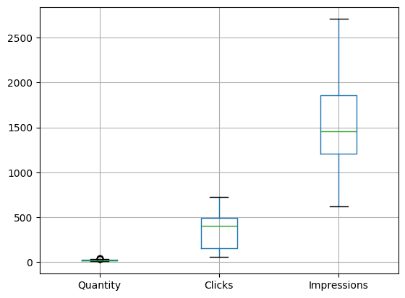
DATA PREPROCESSING AND FEATURE ENGINEERING
Missing values and Duplicate entries were not found in the data.
5 Outliers were Detected in the Quantity variable and they were replaced with 97th percentile.
Multiple features were engineered to improve models performance such as Weekday_Monday, Weekday_Tuesday, etc. and Month_January, Month_February, etc.

Slide 6
EXPLORATORY DATA ANALYSIS

Slide 7
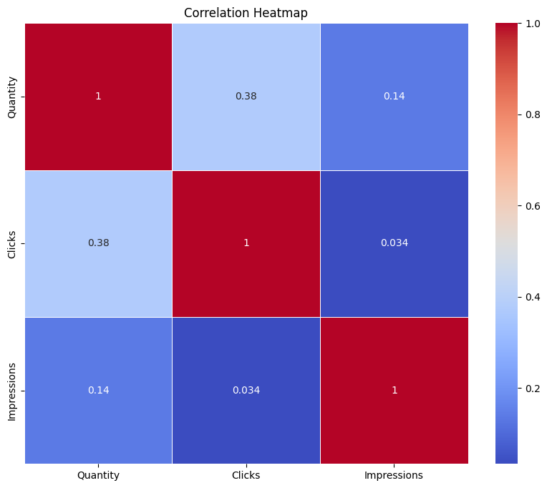
CORRELATION MATRIX
From the correlation matrix, we derive following conclusions:
Clicks have good positive correlation with Quantity
Impressions also have slight positive relation to Quantity
Impressions also have a very minute positive relation to Clicks (more Impressions leading to more Clicks)

Slide 8
VISUALISATIONS

Slide 9
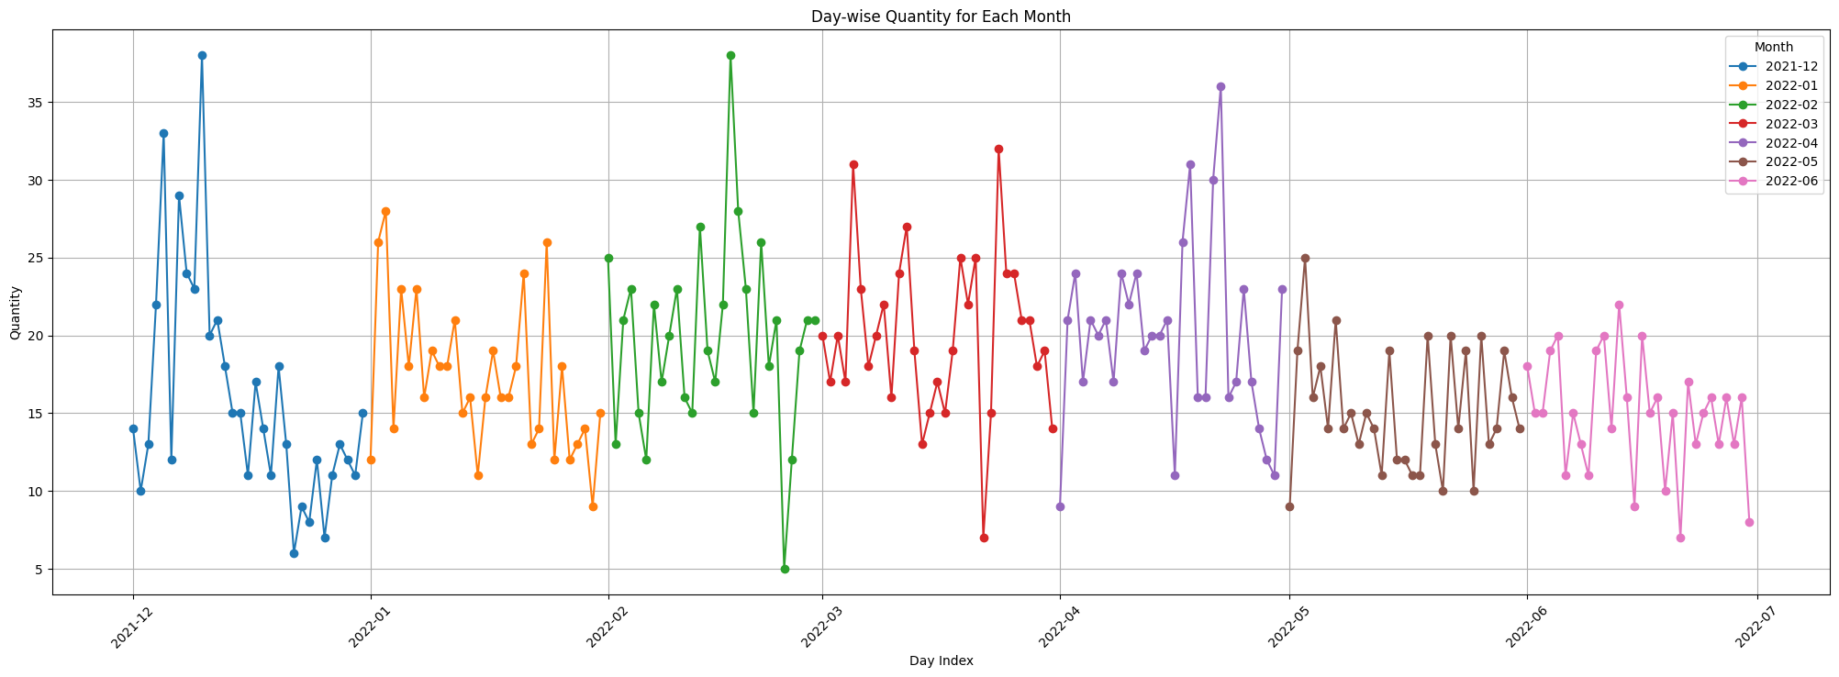
There are more peaks in the month of December, March, April and May.

Slide 10
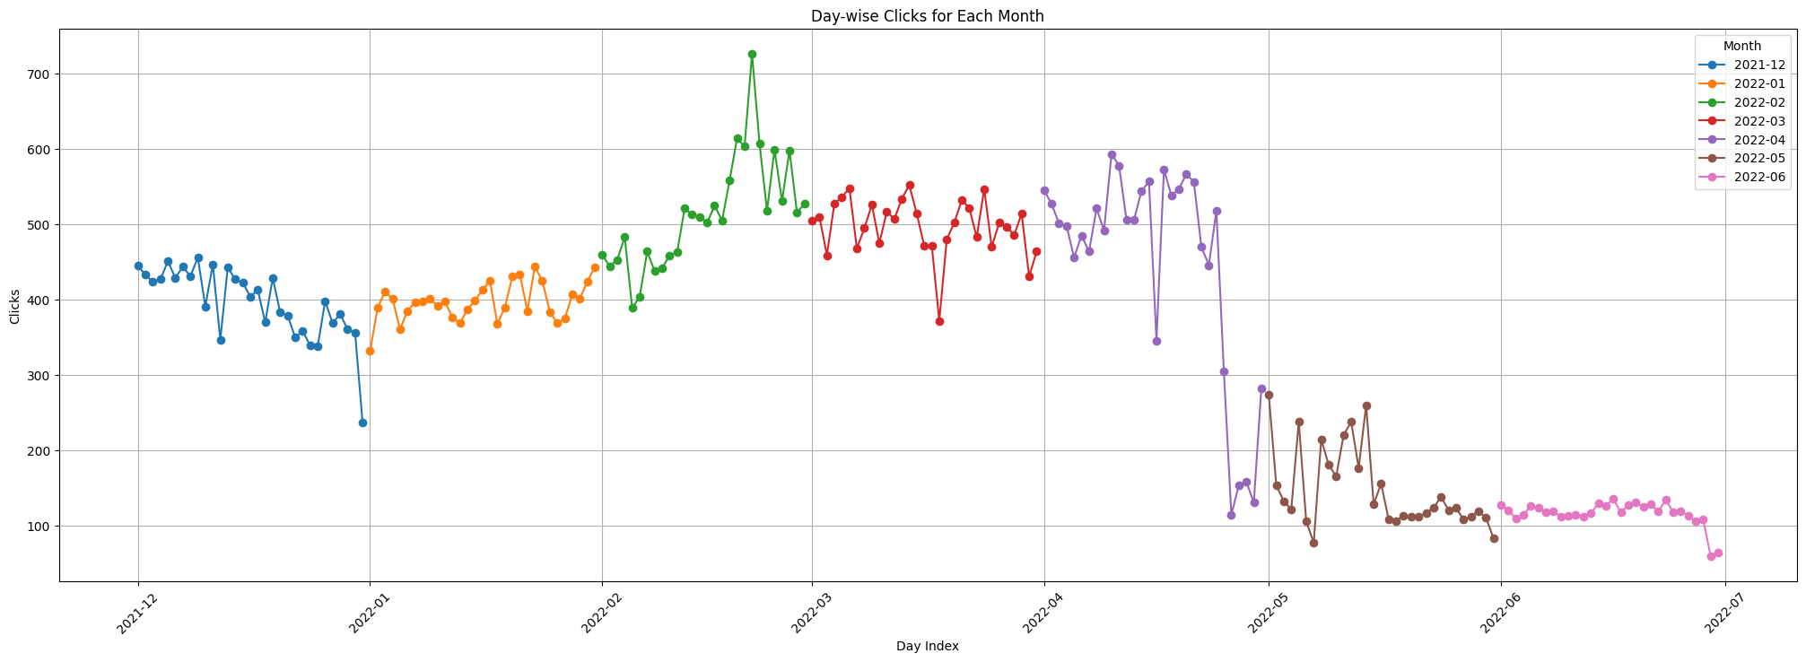
Least clicks
Month of May and June have the lowest Clicks, while February has highest peak.

Slide 11
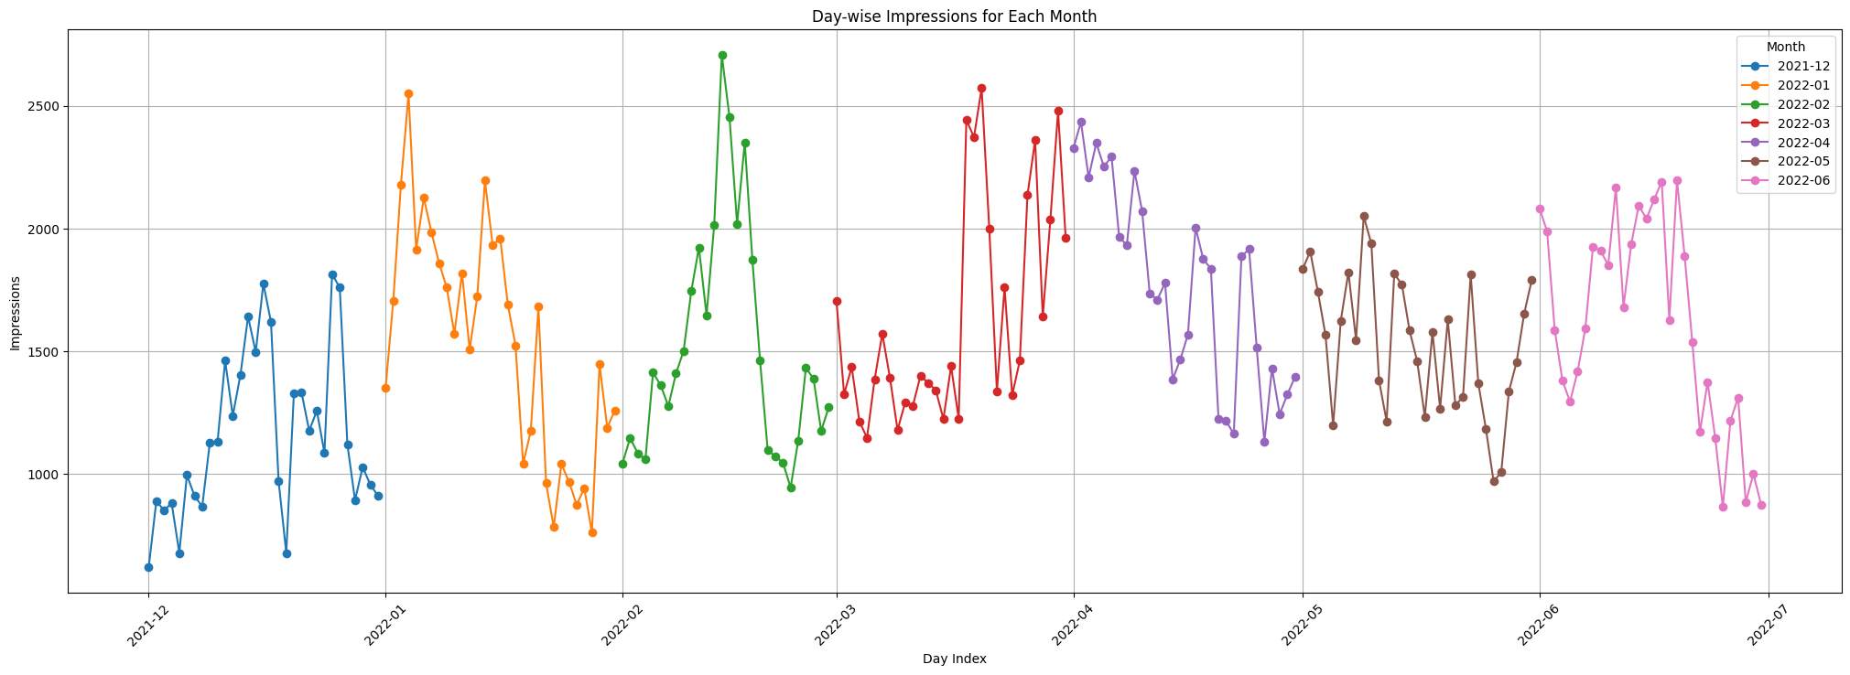
Highest peak of impressions is in the month of March, followed by February and April.

Slide 12
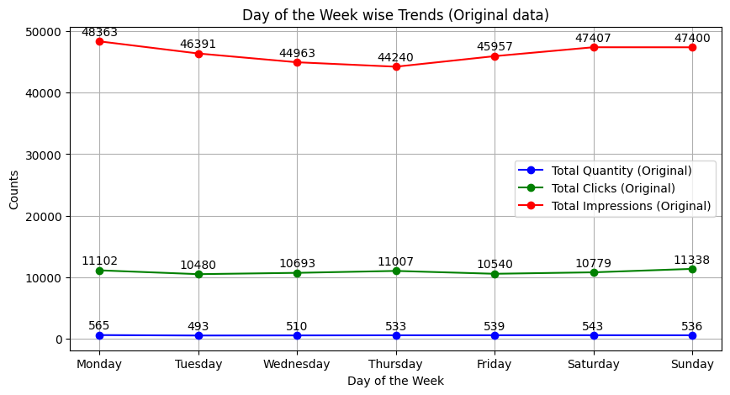
Monday accounts for the most Impressions.
Clicks peaks on Sunday and Monday.
Quantity peaks on Monday, followed by Saturday.

Slide 13
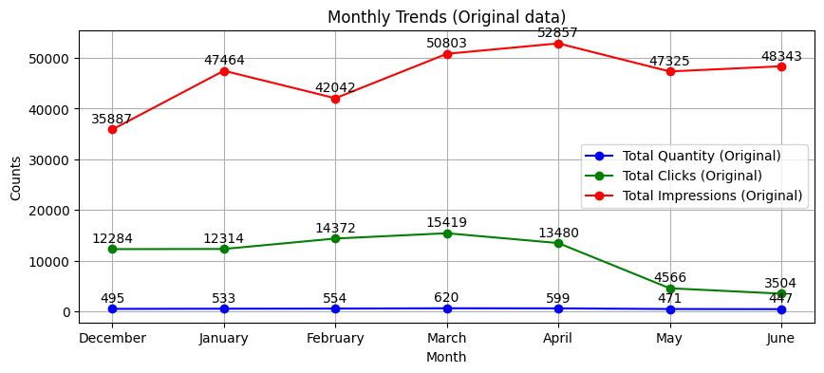
Impressions peak in the month of April.
Clicks peaks in the month of March.
Quantity also peaks in the month of March.

Slide 14
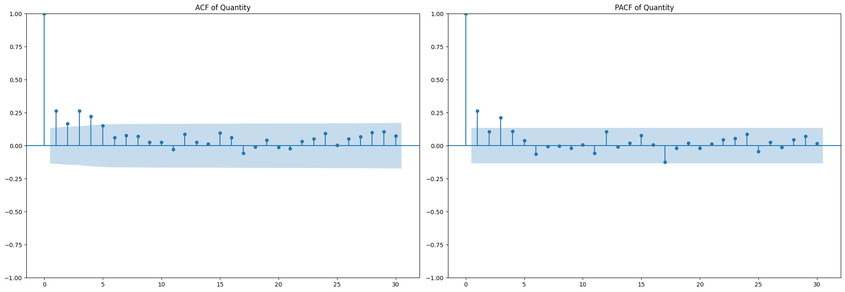
TIME SERIES HYPOTHESES TEST
Data series is found to be stationary for Quantity and Impressions attribute using ADF test.
Hence, order of differencing is zero, i.e. d=0.
In both the ACF and PACF plots, there is a single biggest spike in the beginning.
Hence, the value of p and q are 1 and 1, respectively.
Hence, optimal parameter order is p, d, q = (1, 0, 1)

Slide 15
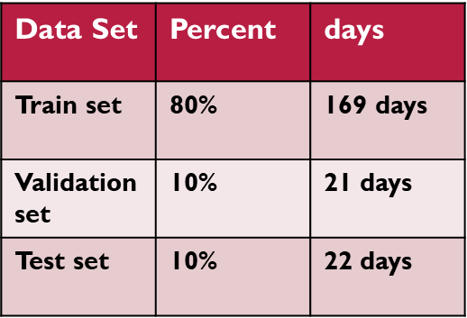
DATA SPLITTING
The data is split into 3 sets in a ratio of 80:10:10
Used to train the model
Used to test the model

Slide 16
MODEL TRAINING AND EVALUATION

Slide 17
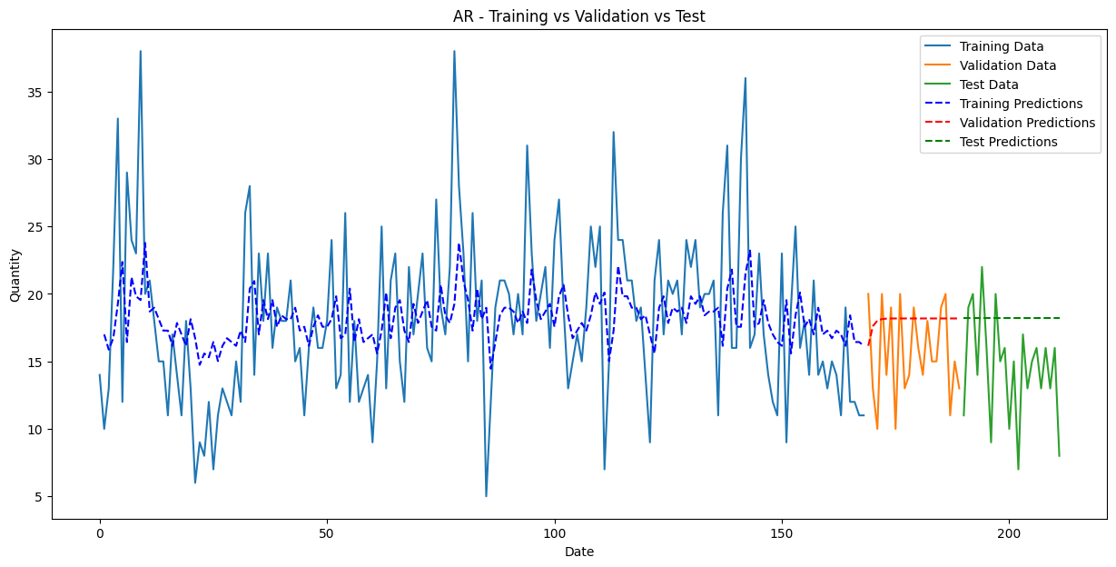

AR Model – Auto regressive
MA Model – Moving Average
Test Set Metrics for AR:
MSE: 27.603
MAE: 4.344
MAPE: 39.291%
R2: -0.878
Adjusted R2: 4.586
Test Set Metrics for MA:
MSE: 27.386
MAE: 4.325
MAPE: 39.12%
R2: -0.863
Adjusted R2: 4.558

Slide 18


ARMA Model
ARIMA Model – AR Integrated MA
Test Set Metrics for ARMA:
MSE: 26.473
MAE: 4.243
MAPE: 38.387%
R2: -0.801
Adjusted R2: 4.439
Test Set Metrics for ARIMA:
MSE: 26.473
MAE: 4.243
MAPE: 38.387%
R2: -0.801
Adjusted R2: 4.439
Both the models show same results, as the order of differencing was zero, i.e. d = 0.

Slide 19
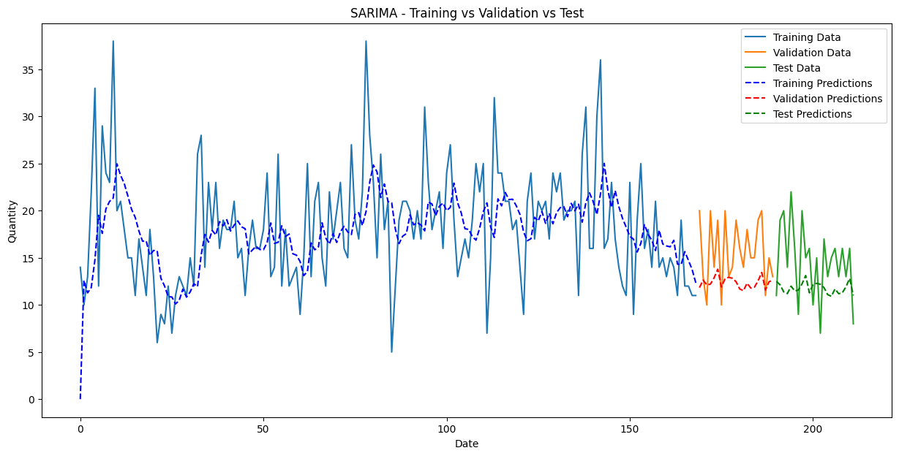
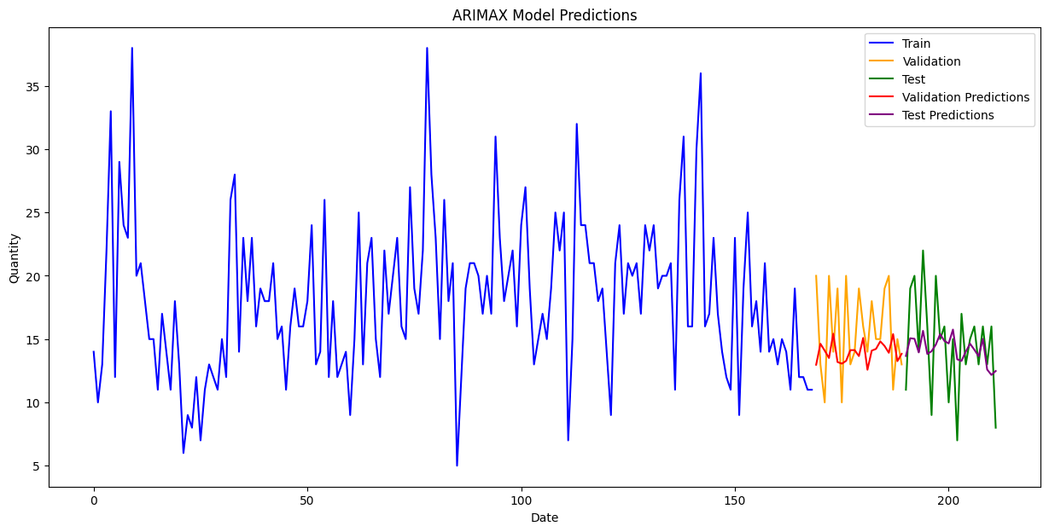
SARIMA Model – Seasonal ARIMA
ARIMAX Model – ARIMA with exog. variables
Test Set Metrics for SARIMA:
MSE: 22.489
MAE: 4.114
MAPE: 28.084%
R2: -0.53
Adjusted R2: 3.921
ARIMAX Test Set Metrics:
MSE: 12.121
MAE: 2.784
MAPE: 22.111%
R2: 0.175
Adjusted R2: -1.887

Slide 20

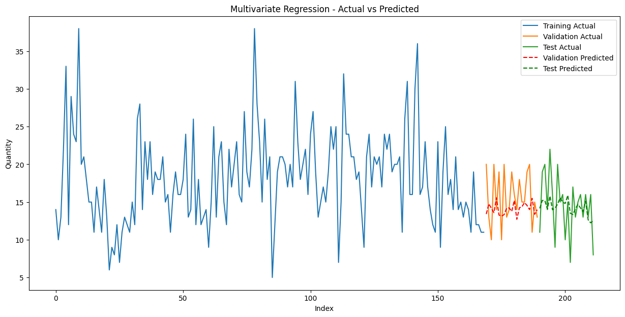
SARIMAX Model
Multivariate Regression
SARIMAX Test Set Metrics:
MSE: 12.081
MAE: 2.785
MAPE: 22.147%
R2: 0.178
Adjusted R2: -1.877
Test Set Metrics for Multivariate Regression:
MSE: 12.114
MAE: 2.792
MAPE: 22.393%
R2: 0.176
Adjusted R2: -1.885

Slide 21
CONCLUSION
The best model is found to be the SARIMAX model with a 12 month seasonality and a group of important features used such as Clicks, Impressions, Weekday_Monday, Weekday_Tuesday, and Month_January, Month_February, etc., followed by the multivariate regression.
The SARIMAX model can be used to forecast the sales quantity for the future.
Metric | Validation Set (SARIMAX) | Test Set (SARIMAX)
MSE | 15.15 | 12.025
MAE | 3.166 | 2.784
MAPE | 19.67% | 22.21%
R² | -0.378 | 0.182
Adjusted R² | -4.51 | -1.864

Slide 22
Annexure
VALIDATION SET METRICS COMPARISON
Error Metrics / Models | AR | MA | ARMA / ARIMA | SARIMA | ARIMAX | SARIMAX | Multivariate Regression
MSE | 18.023 | 17.871 | 14.750 | 20.139 | 15.776 | 15.150 | 15.300
MAE | 3.573 | 3.556 | 3.374 | 3.637 | 3.231 | 3.166 | 3.192
MAPE | 26.54% | 26.26% | 24.465% | 23.13% | 20.08% | 19.67% | 19.937%
R² | -0.639 | -0.625 | -0.341 | -0.831 | -0.434 | -0.378 | -0.391
Adjusted R² | 3.521 | 3.500 | 3.063 | 3.817 | -4.738 | -4.51 | -4.565
TEST SET METRICS COMPARISON
Error Metrics / Models | AR | MA | ARMA / ARIMA | SARIMA | ARIMAX | SARIMAX | Multivariate Regression
MSE | 28.025 | 27.512 | 26.682 | 22.111 | 12.124 | 12.025 | 12.132
MAE | 4.381 | 4.336 | 4.263 | 4.078 | 2.784 | 2.784 | 2.790
MAPE | 35.41% | 35.03% | 34.414% | 27.79% | 22.08% | 22.21% | 22.310%
R² | -0.907 | -0.872 | -0.816 | -0.505 | 0.175 | 0.182 | 0.175
Adjusted R² | 4.337 | 4.276 | 4.177 | 3.633 | -1.887 | -1.864 | -1.889
R² is negative due to the small size of data.

Slide 23
THANK YOU
Please send all questions to:
jatingupta261001@gmail.com

